Slide 1
Azure Data Manager for Energy
Bjørn Atle Vorland
Sr. CSA Core

Slide 2

Azure Data Manager for Energy
Let’s review the current deployment options
Simple and easy deployments

Slide 3
Enterprise Fundamentals
ADME Deployments
Portal – Click-Ops Demo
Bicep – Infrastructure as Code Demo
Experience Lab – End 2 End setup with simple admin portal and some use-cases

Slide 4
Enterprise Fundamentals
ADME Deployments
Portal – Click-Ops Demo
Prerequisites Active Azure Subscription: You'll need the Azure subscription ID in which you want to install Azure Data Manager for Energy Preview. You need to have appropriate permissions to create Azure resources in this subscription Application ID You'll need an application ID (often referred to as "App ID" or a "client ID"). This application ID will be used for authentication to Azure Active Directory and will be associated with your Azure Data Manager for Energy Preview instance. You can create an application ID by navigating to Active directory and selecting App registrations > New registration.
Client Secret Sometimes called an application password, a client secret is a string value that your app can use in place of a certificate to identity itself. You can create a client secret by selecting Certificates & secrets > Client secrets > New client secret. Record the secret's value for use in your client application code. This secret value is never displayed again after you leave this page.

Slide 5
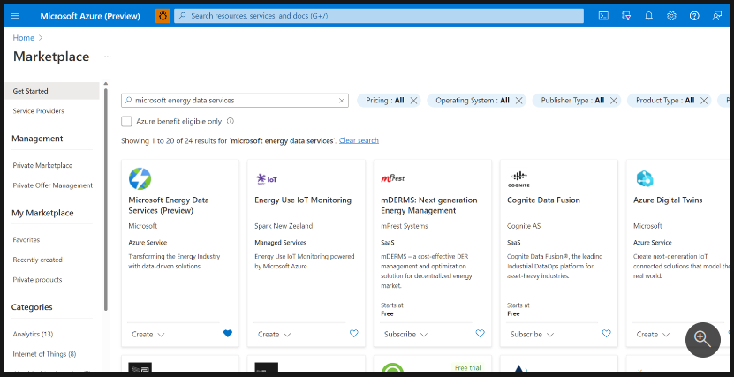
Enterprise Fundamentals
ADME Deployments
Portal – Click-Ops Demo
Save your Application (client) ID and client secret from Azure Active Directory to refer to them later in this quickstart.
Sign in to Microsoft Azure Marketplace
If you have access to multiple tenants, use the Directories + subscriptions filter in the top menu to switch to the tenant in which you want to install Azure Data Manager for Energy Preview.
Use the search bar in the Azure Marketplace (not the global Azure search bar on top of the screen) to search for Azure Data Manager for Energy Preview.

Slide 6
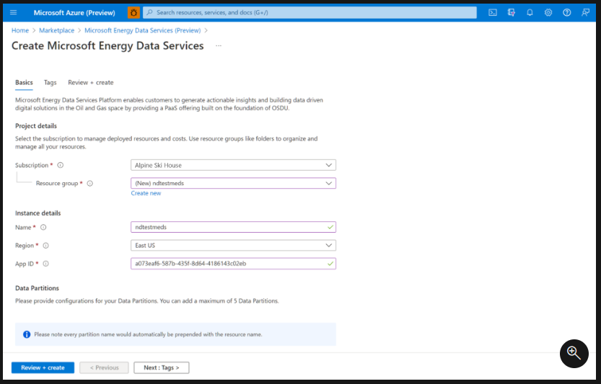
Enterprise Fundamentals
ADME Deployments
Portal – Click-Ops Demo
In the search page, select Create on the card titled "Azure Data Manager for Energy Preview(Preview)".
A new window appears. Complete the Basics tab by choosing the subscription, resource group, and the region in which you want to create your instance of Azure Data Manager for Energy Preview. Enter the App ID that you created during the prerequisite steps.

Slide 7
Enterprise Fundamentals
ADME Deployments
Portal – Click-Ops Demo
Some naming conventions to guide you at this step:
Instance name Only alphanumeric characters are allowed, and the value must be 1-15 characters long. The name is not case-sensitive. One resource group can't have two instances with the same name.
Application ID Enter the valid Application ID that you generated and saved in the last section.
Data Partition name
Name should be 1-10 char long consisting of lowercase alphanumeric characters and hyphens. It should start with an alphanumeric character and not contain consecutive hyphens. The data partition names that you chose are automatically prefixed with your Azure Data Manager for Energy Preview instance name. This compound name will be used to refer to your data partition in application and API calls.
Note Azure Data Manager for Energy Preview instance and data partition names, once created, cannot be changed later.

Slide 8
Enterprise Fundamentals
ADME Deployments
Bicep – Infrastructure as Code Demo
Infrastructure as Code az group create --name <resource-group-name> --location <location>

Slide 9
Enterprise Fundamentals
ADME Deployments
Bicep – Infrastructure as Code Demo
Infrastructure as Code update the parms in the bicep file in the repo. param location string = 'eastus’ param dataPartitionNames string = 'demodata’ param admeName string = 'adme’ param authAppId string = 'Replace with your authAppId'

Slide 10
Enterprise Fundamentals
ADME Deployments
Bicep – Infrastructure as Code Demo
Infrastructure as Code az deployment group create --resource-group <resource-group-name> --template-file <filename>.bicep

Slide 11
Enterprise Fundamentals
ADME Deployments
Experience Lab – End 2 End setup with simple admin portal and some use-cases
Experience Lab – Experience Lab is an automated, end-to-end deployment accelerator for Microsoft Azure Data Manager for Energy that provides easy, fast deployments with sample dataset(s) for learning, testing, demo and training purposes for customers and partners. GitHub - microsoft/azure-data-manager-for-energy-experience-lab: Experience Lab is a set of utilities that assist in creating instances of Microsoft Azure Data Manager for Energy, performing data loads, and performing basic management operations.

Slide 12
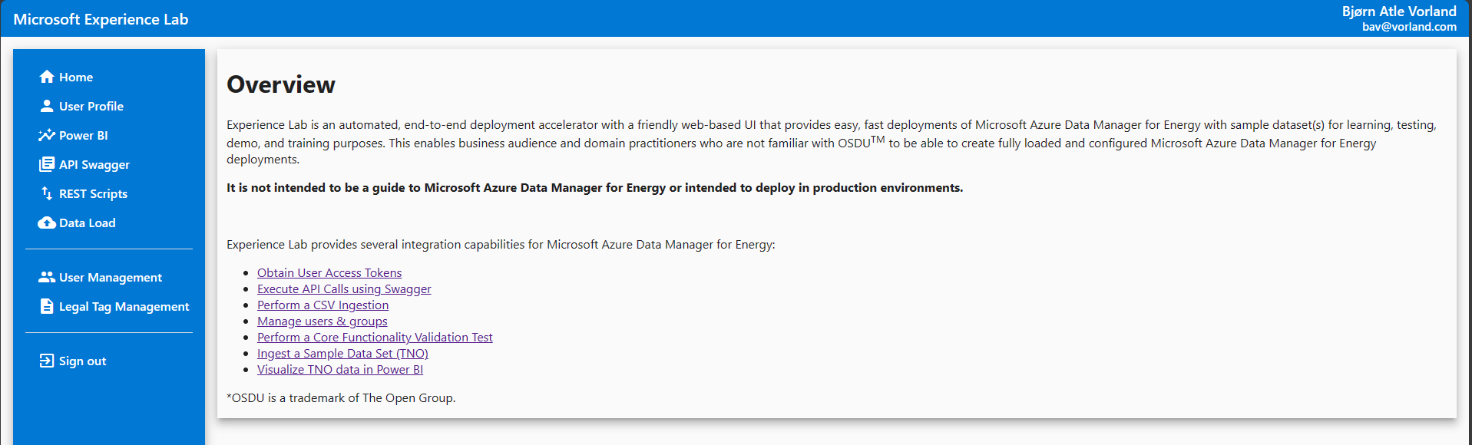
Enterprise Fundamentals
ADME Deployments
Experience Lab – End 2 End setup with simple admin portal and some use-cases

Slide 13

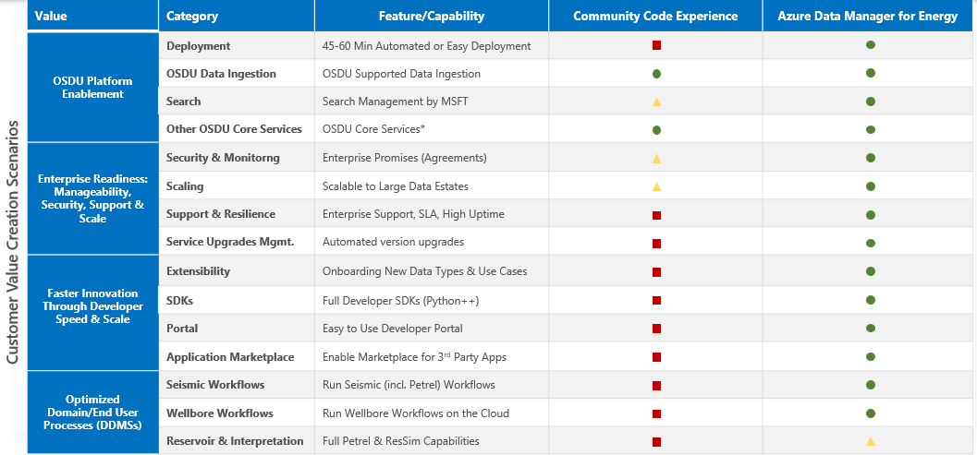
OSDU and ADME Experience Features Comparison
Provide an easy & secure data deployment , ingestion, search, scale and integration experience to meet customers industry specific needs
Does not exist or not ideal experience
Partial or basic experience
Full MSFT backed experience
* Other OSDU Services Include Ingestion, DDMs, Search, Standard APIs plus Reference and Helper Services. No Migration from Community to Private and from Private to Public as this is using test nonproduction data.

